Slide 1



AI Unplugged.
Demystifying generative AI
Digital Schoolhouse, 18a Blackbull Yard, 24-28 Hatton Wall, London EC1N 8JH.
Copyright © 2025 Digital Schoolhouse. All rights reserved.

Slide 2
The challenge.
In this hands-on unplugged lesson, you will learn how:
Generative AI generates original content based on a prompt
Generative AI uses training data to ‘learn’

Slide 3
Computing definition.
AI is an acronym for artificial intelligence. AI are algorithms designed to mimic problem-solving and decision-making capabilities.

Slide 4
Generative AI.
Generative AI is artificial intelligence that responds to a user’s prompt or request with generated original content, such as audio, images, software code, text or video.
IBM
E.g. ChatGPT, DALL-E, Copilot, Gemini

Slide 5
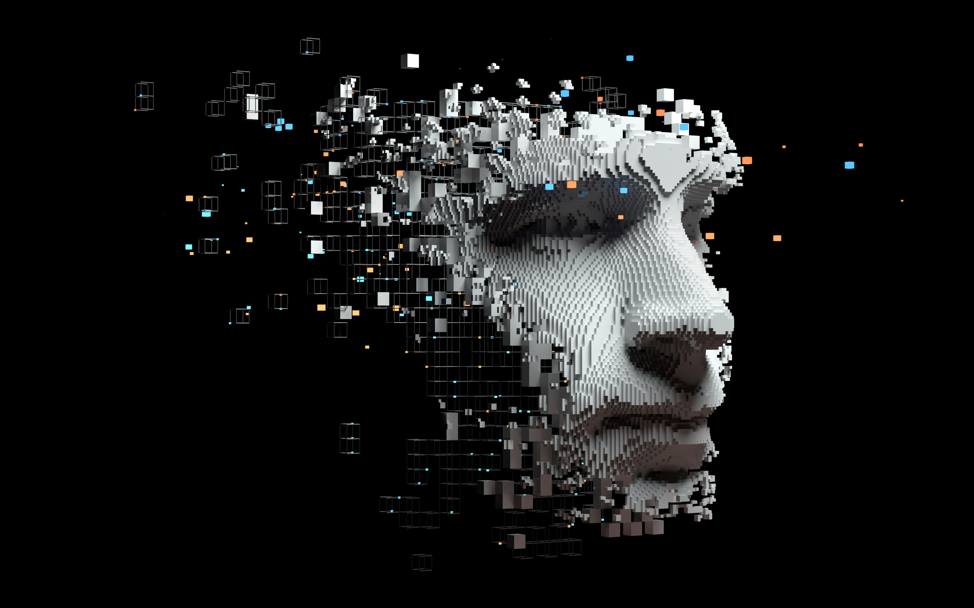
What does generative AI do?

Slide 6
Generative AI responds to a user’s prompt by generating content.

Slide 7
Generative AI.
Imagine you are a generative AI. Respond to the user’s prompt with your own content:
Create a line drawing of a bird wearing a top hat.

Slide 8
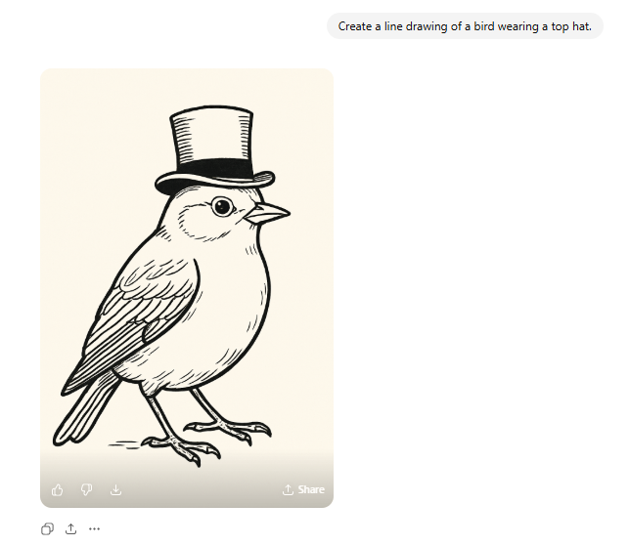

Slide 9
How does generative AI know what to generate?

Slide 10
Generative AI learns what to generate by finding trends in huge sets of data and creating a data model. This model is then used as the basis for what it will generate.

Slide 11
Generative AI.
Let’s create a data model that could be used to generate an output for this prompt:
Draw a circle.

Slide 12
Creating circles.
Draw a circle on the transparent sheet given to you.

Slide 13


Slide 14
Creating circles.
Let’s debrief this activity
…collected training data
…created a data model for a circle
…used this model as the basis for generating a drawing of a circle
Generative AI needs to be trained to ‘learn’ how to generate something.

Slide 15
Generative AI.
Our first data model is very simple, let’s create a new data model to generate an output for this more complex prompt:
Create a line drawing of a cat.

Slide 16
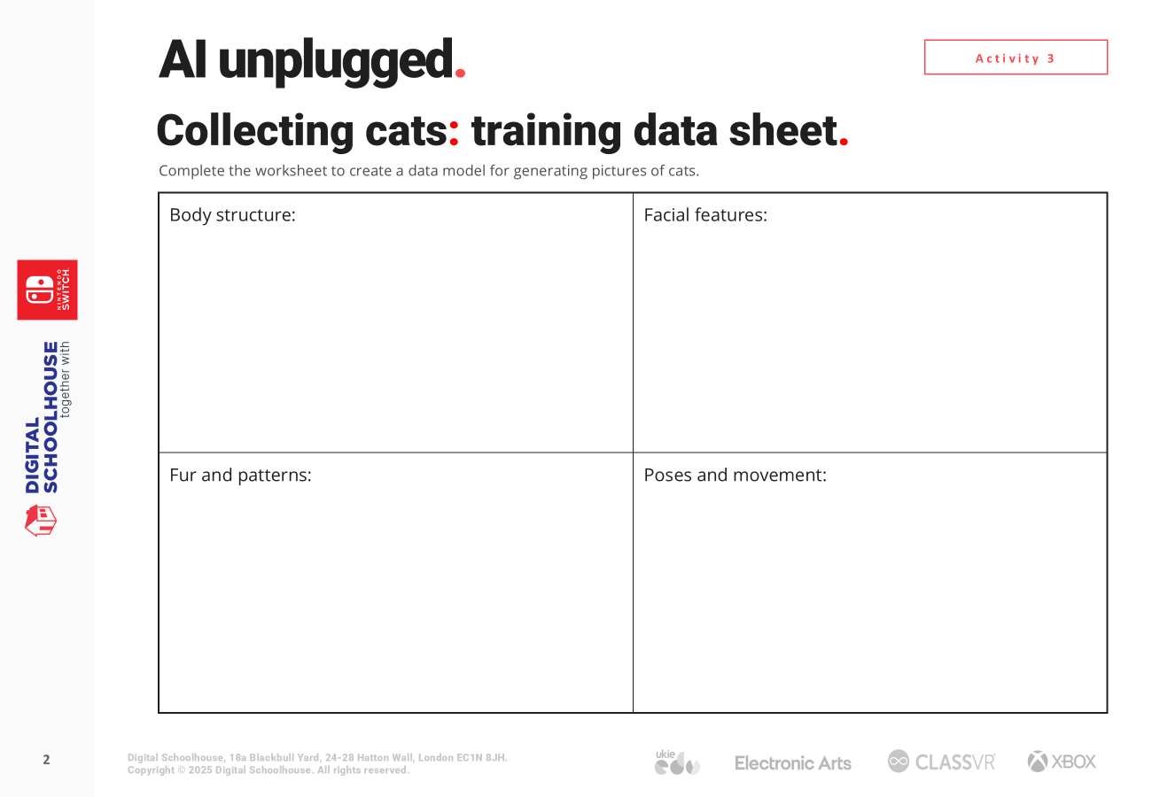

Collecting cats
Complete the cat data model training sheet.

Slide 17
Collecting cats: Creating our model
Body structure:
Facial features:
Fur and patterns:
Poses and movement:

Slide 18
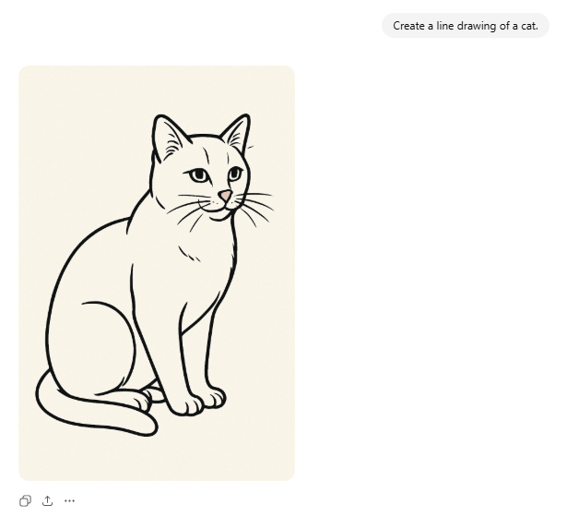

Slide 19
Collecting cats.
Let’s debrief this activity
…collected training data
…created a data model for a cat based on probability
…used this data model to generate an output based on the cat prompt
Generative AI needs to be trained on lots of data to ‘learn’ how to generate something.

Slide 20


Generative AI.
Generative AI is artificial intelligence that responds to a user’s prompt or request with generated original content, such as audio, images, software code, text or video.
IBM
Generative AI works by creating content based on a prompt.
To ‘teach’ a generative AI how to generate something, training data is used to create a model of the output.
Generative AI data models use probability to identify patterns in their training data and then apply these findings to generate an output.

Slide 21
The challenge.
In this hands-on unplugged lesson, you will have learnt how:
Generative AI generates original content based on a prompt
Generative AI uses training data to ‘learn’

Slide 22
AI Unplugged.
Demystifying generative AI
Digital Schoolhouse, 18a Blackbull Yard, 24-28 Hatton Wall, London EC1N 8JH.
Copyright © 2025 Digital Schoolhouse. All rights reserved.

